Slide 1

REUTERS/HO NEW
PRIVACY AND BIG BEHAVIORAL DATA
IN THE B2B SPACE
James Powell
CTO, Thomson Reuters

Slide 2
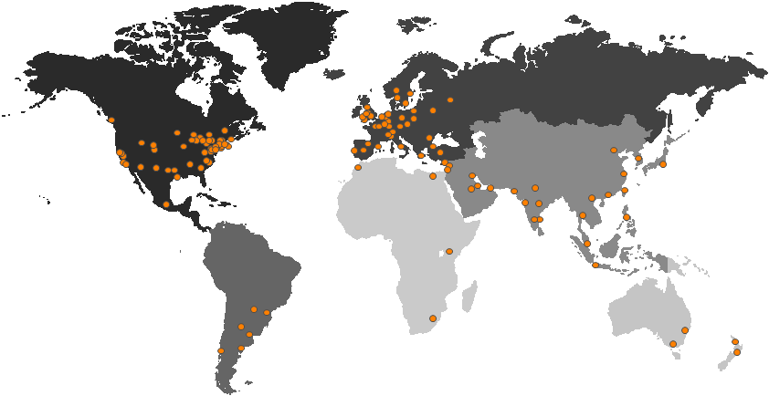
Thomson Reuters
PROFESSIONAL DIVISION – $5.4B
We are the leading source of intelligent information for the world’s businesses and professionals, providing customers with competitive advantage.

Slide 3





Thomson Reuters
PROFESSIONAL DIVISION – $5.4B
MARKETS DIVISION – $7.5B
PROFESSIONAL DIVISION – $5.4B
MEDIA: $.3B
Reuters news and information reaches billions of people daily
LEGAL: $3.6B
Westlaw is relied upon by 99% of the National Law Journal's top 250 U.S. law firms
FINANCIAL: $7.2B
Provides financial applications for over half a million professionals globally
TAX & ACCOUNTING: $1.0B
Checkpoint is used by all of the top 100 U.S. accounting firms
HEALTHCARE & SCIENCE: $.8B
Informing healthcare decisions affecting over 150 million lives
Used by over 20 million researchers worldwide
REUTERS images

Slide 4

SCALE OF DATA

Slide 5
How we manage data is critical to our business of delivering information to customers
In our Markets Content group, the data we hold on some 50,000 active companies represents over 95% of the world’s market value. The data cache rivals the 20 million books of the U.S. Library of Congress—in digital format
Our Professional Shared Technology Services manages about 11 Petabytes of storage across their data centers globally
In our Healthcare & Science and Tax & Accounting businesses alone, we manage 1.5 Petabytes of data
The storage capacity of our Markets Content, Technology & Operations data centers is four Petabytes equivalent to 1 million DVDs or more than twice the size of all libraries in the US
Our Open Calais service, the public version of the Calais service, processes more than
five million documents per day

Slide 6

DRINKING FROM THE FIRE HOSE
INTELLIGENT INFORMATION
User
Context
Behavior
REUTERS/John Gress
Notes:
Information is growing at an ever increasing rate. On the data feeds we provide our financial service customers the update rates are pushing beyond 700,000 updates per second – far beyond the rates that a human eye can detect let alone react to. So for some time we have been using the filters of user, context and behavior to deliver exactly the right information, at the right time to support a decision.
In the B2B context the user information is a set of participants in a process rather than a loose association of friends or friends of friends. The context doesn’t necessarily mean a physical location but more of a situation – an aggregation of events. Finally the behavior is providing the benefit (feedback) of the experiences of others in similar situations.

Slide 7
PRIVACY

Slide 8

Surviving the behavioral data tornado
BIG BEHAVIORAL DATA
New business models
New consumer products
Impact on individual privacy
IMPLICATIONS FOR B2B?
Notes:
Dramatic increases in compute power, storage capacity and end user engagement have reached unprecedented scale and enabled access to big behavioral data. New business models leverage this new type of data to deliver a wave of new consumer products. The extraordinary success of these models is driving the desire for more and more invasive behavioral data into a tornado of increasing strength. In the mean time, on the ground, significant damage is being inflicted upon the privacy of the individual. How does this fast emergence of products and services based on big behavioral data affect firms that offer B2B products and services?

Slide 9

Consumer privacy concerns are on the rise
Large scale experimentation
Consumer awareness
REUTERS/Daniel Munoz
Notes:
Today’s consumers, especially younger consumers (the “Millenials”), seem willing to forego privacy in return for free/low cost products and services that are easier to use. As many millions of consumers buy and sell products using the web, the unprecedented scale of transactions provides opportunities for extensive behavioral data experimentation by many entities. However, following recent high profile missteps, there is an increasing awareness of products that capture and leverage an individual’s online behavior. A rising tide of public awareness is driving companies, industry and government responses. However, business model experiments continue to further erode privacy while existing regulations and consumer education are lagging further and further behind.

Slide 10

Privacy concerns for B2B are also on the rise
BARRIERS TO ADOPTION
Consumerization
Ambiguity
Immaturity
REUTERS/Henry Romero
Notes:
“Consumerization” of IT blurs the boundaries between B2C and B2B. There are several drivers of consumerization: Millennials enter the workforce and want to bring their consumer products into the workplace. Better connectivity facilitates working from home. Finally, enterprise customers are excited about taking advantage of low-cost, large-scale consumer applications. However, counter to this shift, companies are required to respond to legislation and develop new policies to better protect the privacy of the individual and of their customer’s data. As a consequence, companies that are excited about taking advantages of consumer applications that leverage behavioral data, also have increasing concerns about their privacy and security implications. In the B2B space, these concerns are exacerbated by the added complexity of a longer customer value chain, multiple vendors and partners, and are primarily focused around types of data, data location, ownership and lifecycle.
In the B2B space, customers cannot tolerate data location ambiguity. For example, cultural differences in privacy expectations and requirements have led to an extremely heterogeneous global regulatory landscape. Thus, privacy requirements in contracts with global companies have become extremely complex. Lastly, behavioral data collected by consumer products has no defined owner and lifecycle and maybe resold and aggregated in ways not foreseen by the user. These issues may prove to be an insurmountable barrier to adoption for consumer software for B2B use.

Slide 11

Delivering solutions to B2B
Reputation
Legitimacy
REUTERS/Ilya Naymushin
Notes:
Thomson Reuters, with 150 years of reputation and legitimacy with customers, and with a presence in over 100 countries, is the worlds most trusted source of intelligent information for the worlds businesses and professionals.
As a B2B provider, Thomson Reuters is already delivering cloud services with well-defined data location, lifecycle, ownership and type in highly regulated industries. Today we provide products that use the behavioral data of professionals to enhance performance but we don’t share the data with anyone, anywhere and we aggregate the information to obfuscate the behavior of the individual. We recognize the opportunities that analyzing behavioral data may offer but are cognizant of the pitfalls as standards for privacy are different for Individuals as professional vs. private citizen

Slide 12
Privacy As Shareholder Value
Tomorrow
Cost Avoidance
& Reduction
Leveraging
Behavioral
Data
Internal
External
Research
& Compliance
Establishing
Reputation &
Legitimacy
Today
Creating sustainable value - Stuart L. Hart and Mark B. Milstein - Academy of Management Executive, 2003, Vol. 17, No. 2
Notes:
At Thomson Reuters, we believe that actively researching privacy needs and being compliant with the heterogeneous global regulatory landscape helps us avoid the costs of implementing privacy after the fact and provides the opportunity to improve and standardize processes across products. By leveraging our reputation and legitimacy we can deliver behavioral data in our products and services in a manner that meets B2B needs for well-defined data types, location, data ownership and lifecycle.

Slide 13
KEYS TO SUCCEED

Slide 14

Keys to succeed in B2B
Treat behavioral data differently
Consumerization may not translate in the B2B
Maintain compliance
Establish reputation
REUTERS/Stefano Rellandini
Notes:
Implications how behavioral mining is use to deliver more context
cannot assume that consumerization, millenials may not translate in B2B

Slide 15


